Slide 1

Lecture
on
“CBNST LAB –PMA-402”
by
Akansha Gupta
DEPARTMENT OF COMPUTER SCIENCE AND ENGINEERING
GRAPHIC ERA DEEMED TO BE UNIVERSITY

Slide 2
NEWTON BACKWARD INTERPOLATION METHOD

Slide 3
Newton Backward Interpolation
If the data size is big then the divided difference table will be too long. Suppose the desired intermediate value at which one needs to estimate the function falls towards the end or say in the second half of the data set then it may be better to start the estimation process from the last data set point. For this we need to use backward-differences and backward difference table.

Slide 4
Backward Differences
The differences y1 – y0, y2 – y1, ……, yn – yn–1 when denoted by dy1, dy2, ……, dyn, respectively, are called first backward difference. Thus the first backward differences are :

Slide 5
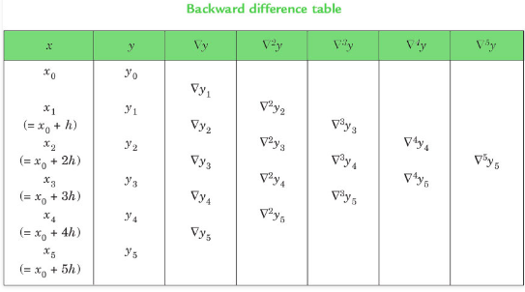
Backward Difference Table

Slide 6
Newton Backward Interpolation Formula
This formula is useful when the value of f(x) is required near the end of the table. h is called the interval of difference and u = ( x – an ) / h, Here an is last term.

Slide 7
Pseudo code for Newton Backward interpolation Method
NEWTONBACKWARD()
{
Read n //number of observation
For j = 0 to n-1 (step 1)
For i = 0 to 1
Read a[j][i] // read the given values say x and y
End For
End For
//Creating backward difference table
For j = 2 to n (step 1)
For i = j-1 to n-1 (step 1)
a[i][j]=a[i][j-1]-a[i-1][j-1]
End For
End For

Slide 8
//Display backward differential table
For i = 0 to n-1 (step 1)
goto next line
For j = 0 to i+1 (step 1)
print a[i][j]
End For
End For
Read x // value for which we want to find the y
If ((x<x[0]) OR (x>x[n-1]))
Print "input value is out of bound"
Exit
EndIf

Slide 9
//Evaluating u (or p)
u= (x-a[n-1][0])/(a[1][0]-a[0])[0])
u1=u
y = a[n-1][1]
k=1
For j = 2 to n (step 1)
y = y + (u1*(a[n-1][j]/k))
u1= u1*(u + (j - 1))
k = k * j
End For
Print "Result is : " y
}

Slide 10
THANKS
https://youtu.be/XptHFaJV8mo

